Slide 1
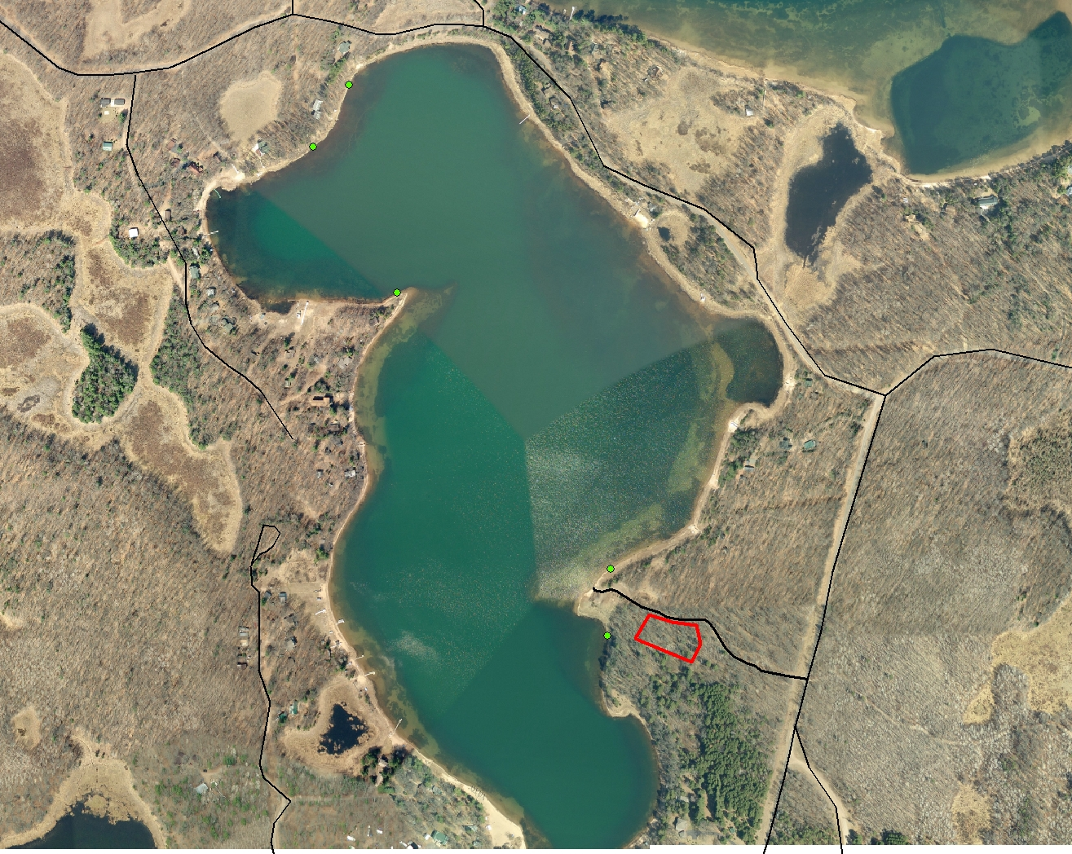
MALLARD LAKE FISH HABITAT IMPROVEMENT PROJECT
“FISH STICKS”
A project to increase the amount of quality fish habitat in the littoral zone of Mallard Lake
Sponsored by: Mallard Lake Association
And
Burnett County Land and Water Conservation Department

Slide 2
As much as 90% of aquatic life lives in or
passes through the littoral zone at some
stage in their life cycle!!!

Slide 3
Fish benefit from increased habitat diversity provided by aquatic plants and woody structure in lakes.

Slide 4
Bony Lake, Wisconsin – Fish Sticks provide quality habitat for all species

Slide 5
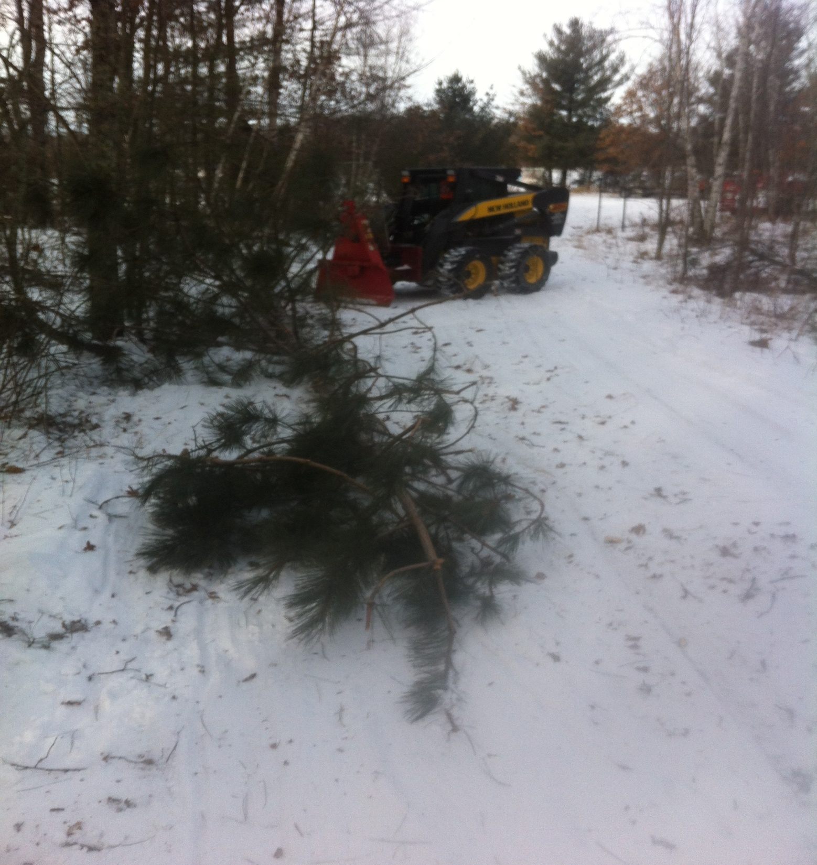
Skidding out whole trees to be assembled
into fish sticks structures

Slide 6
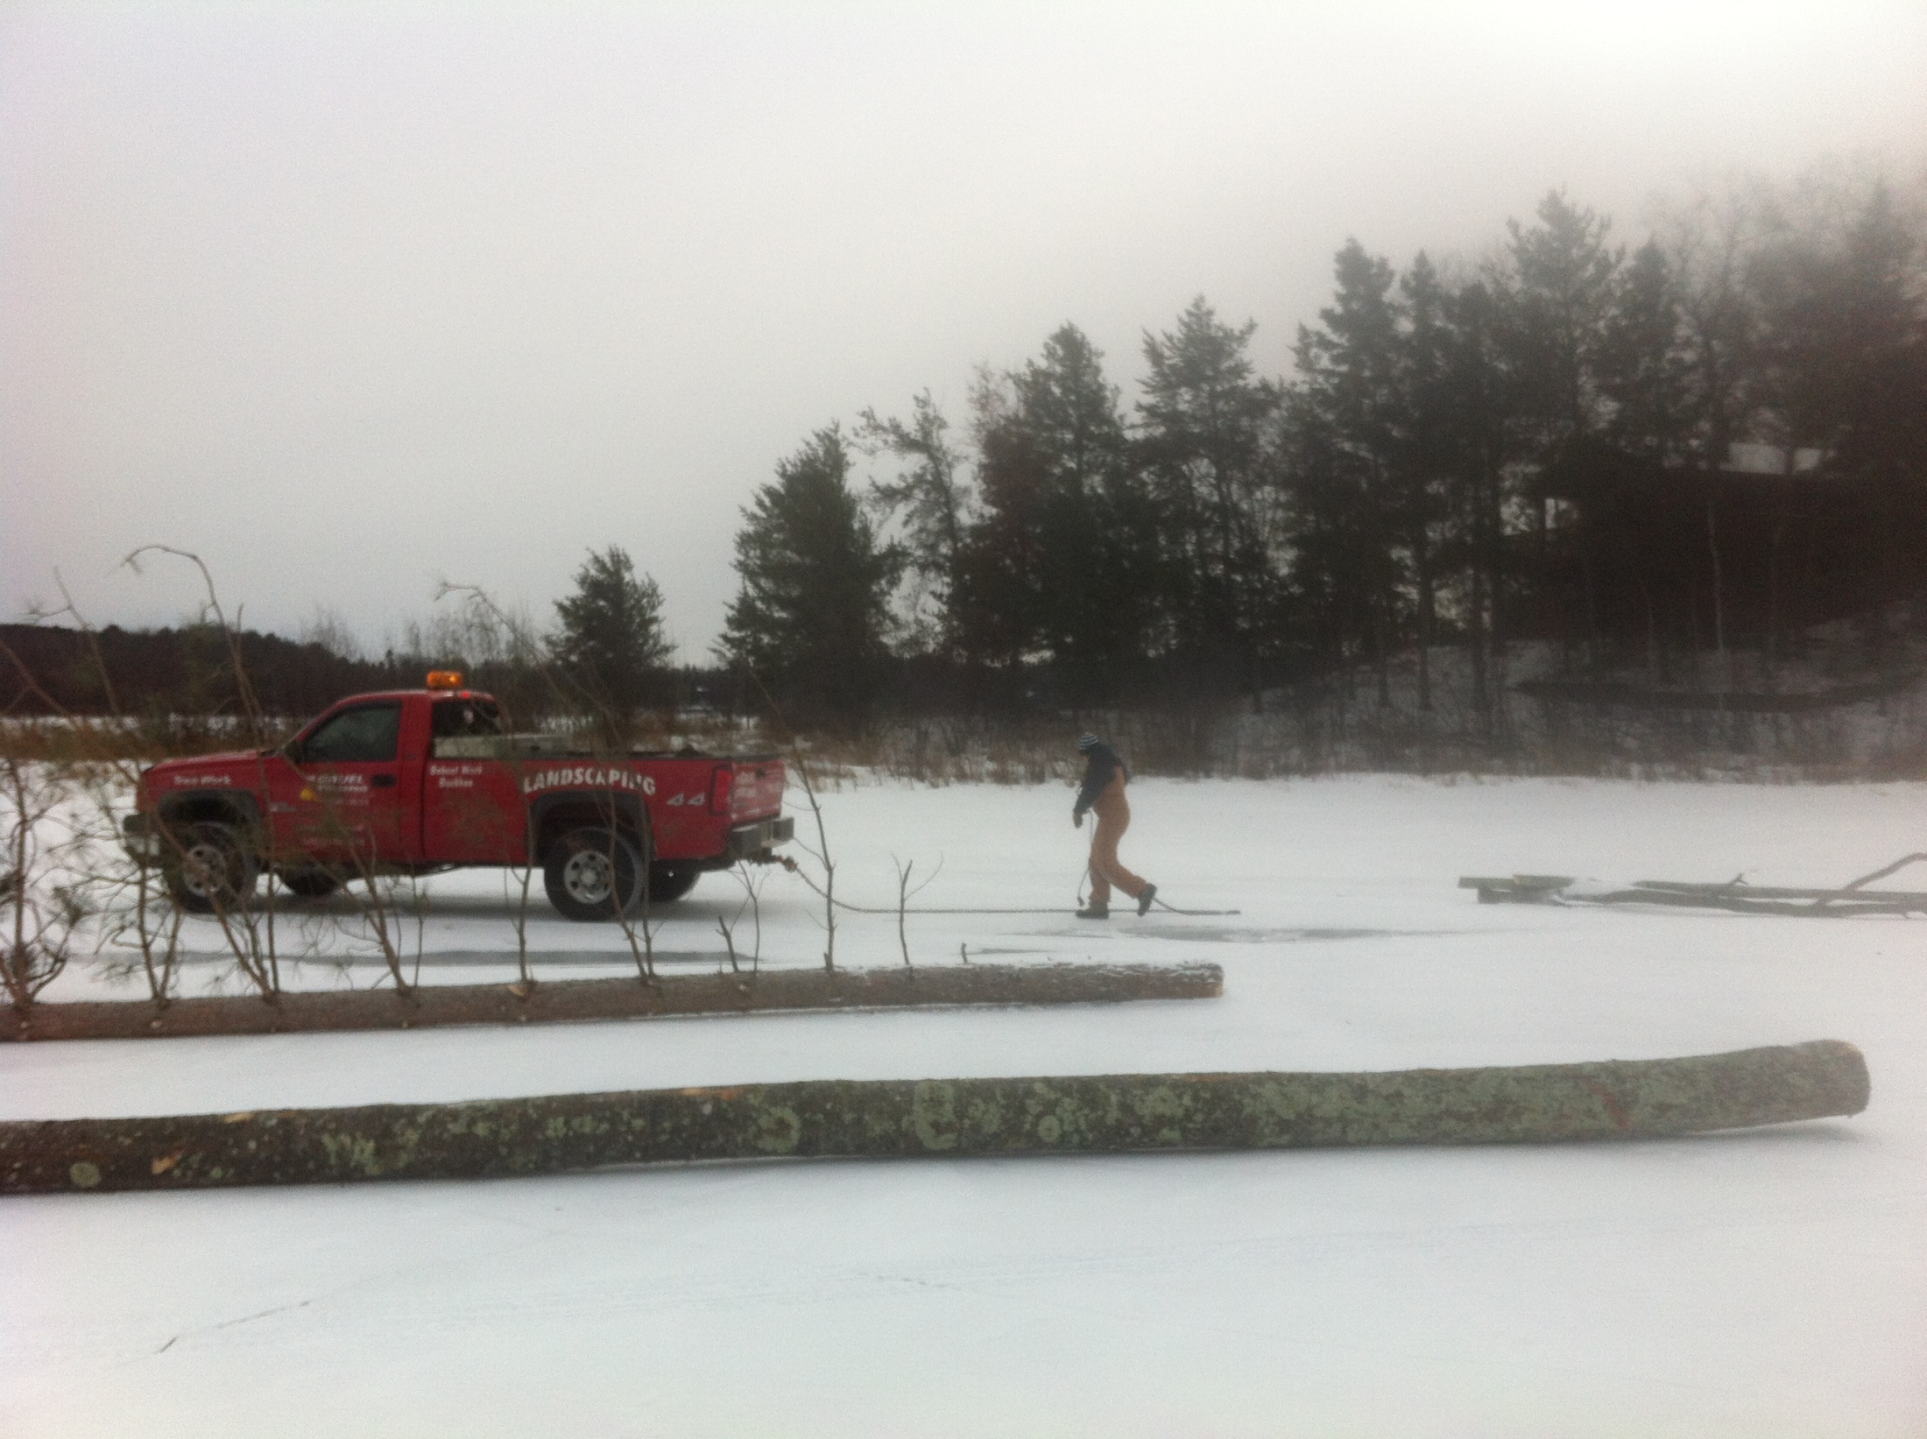

Slide 7
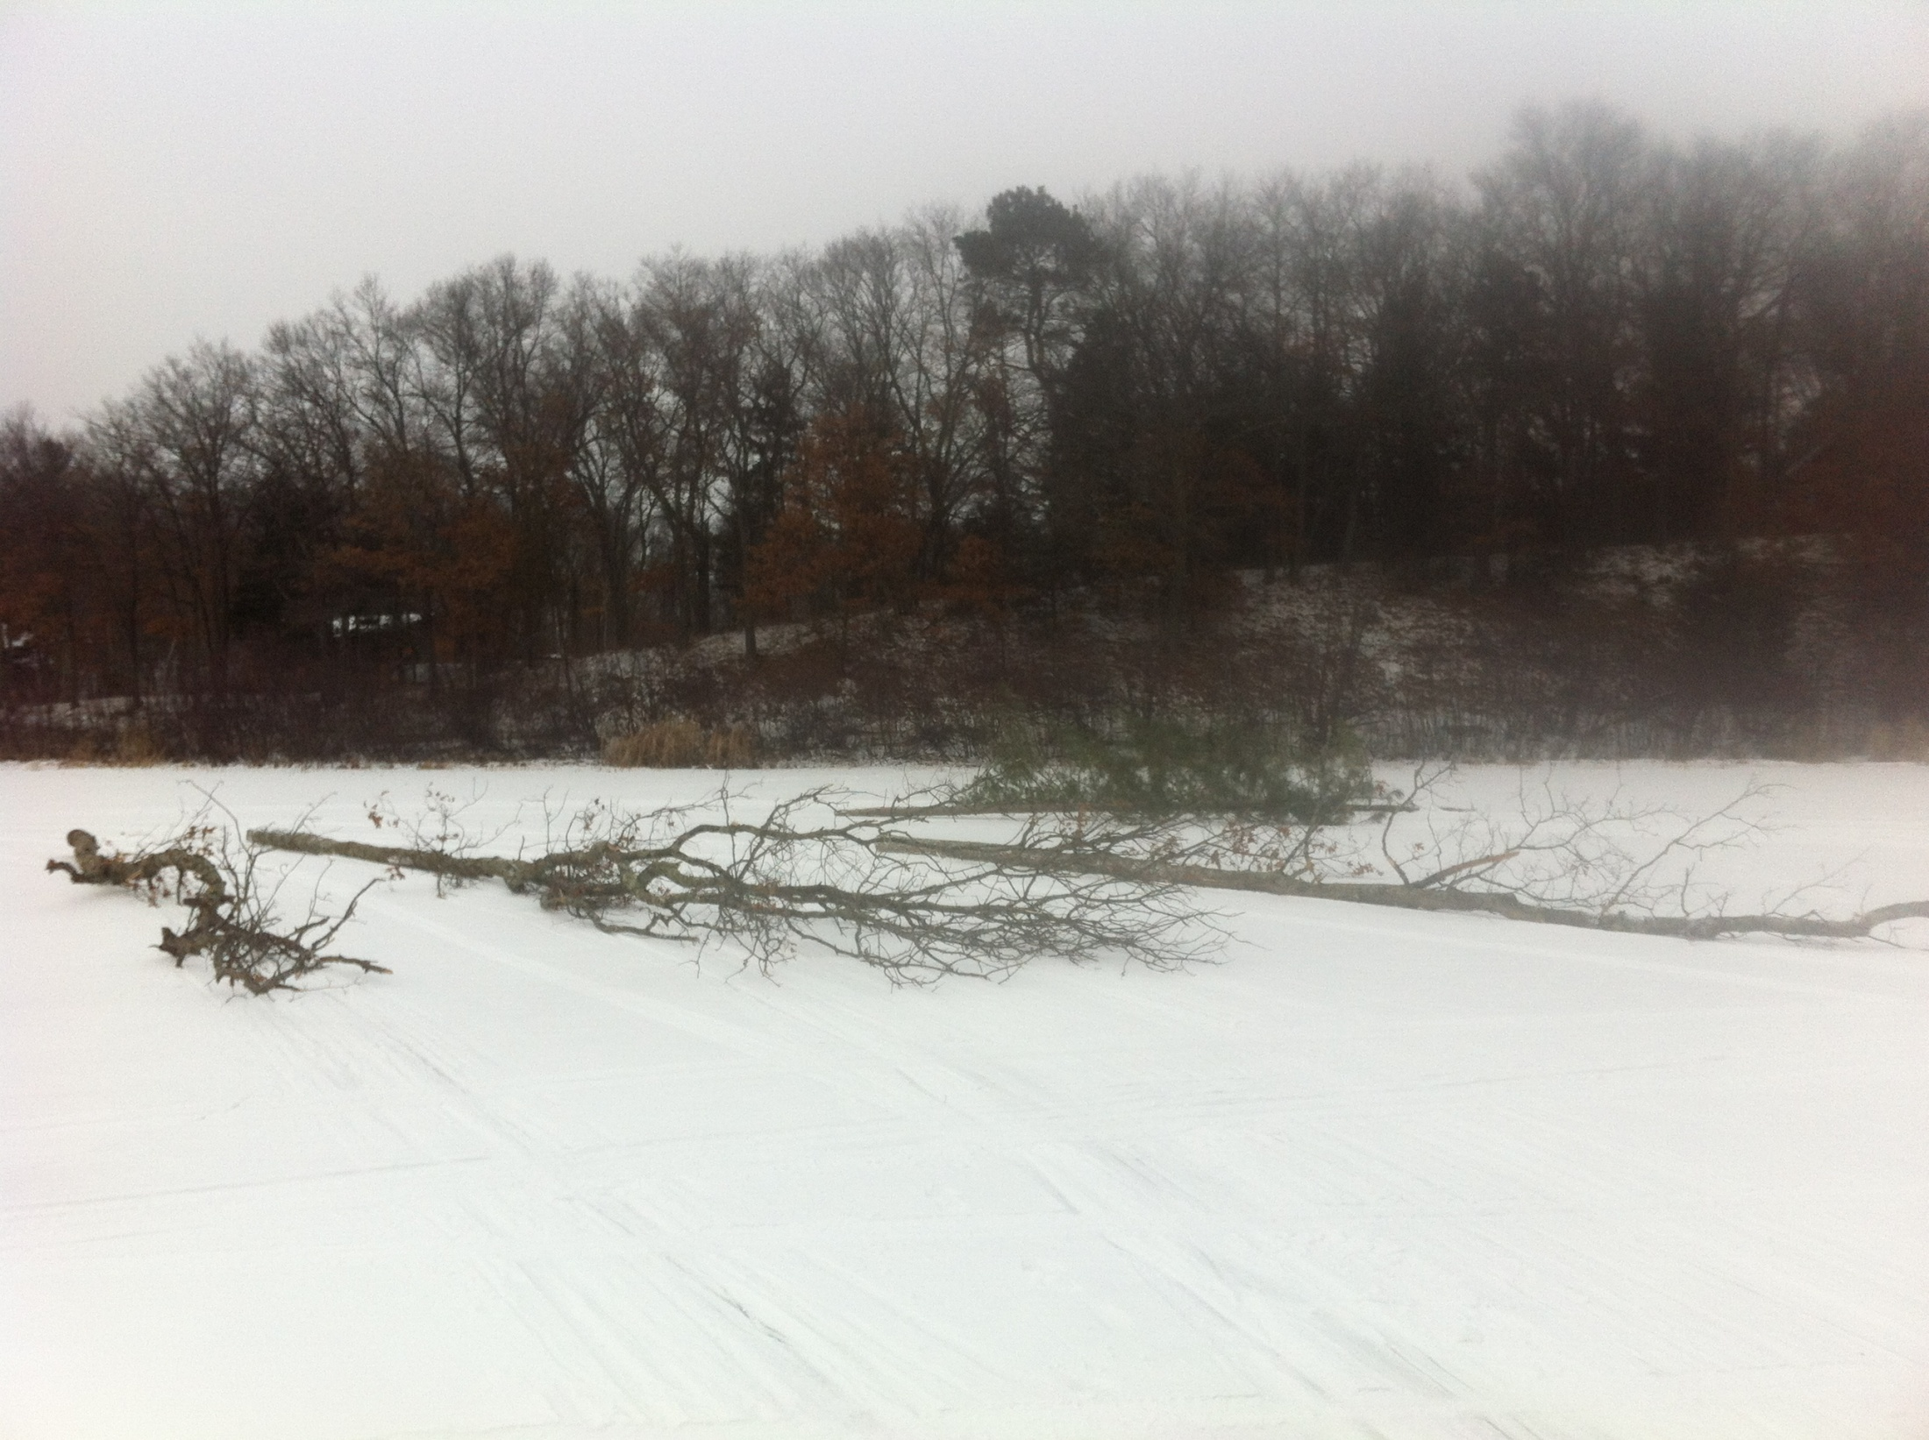

Slide 8
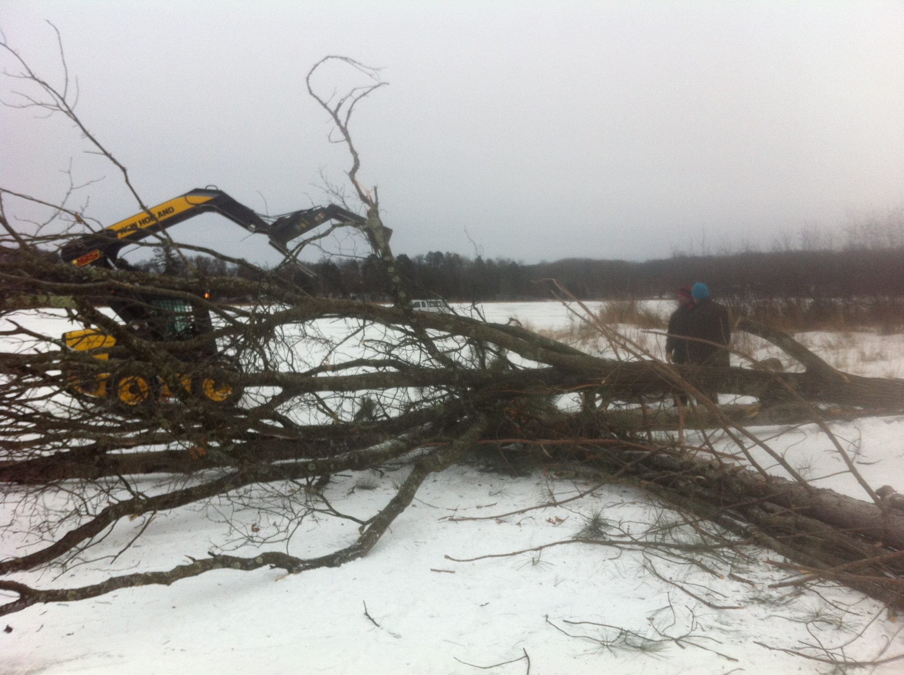

Slide 9
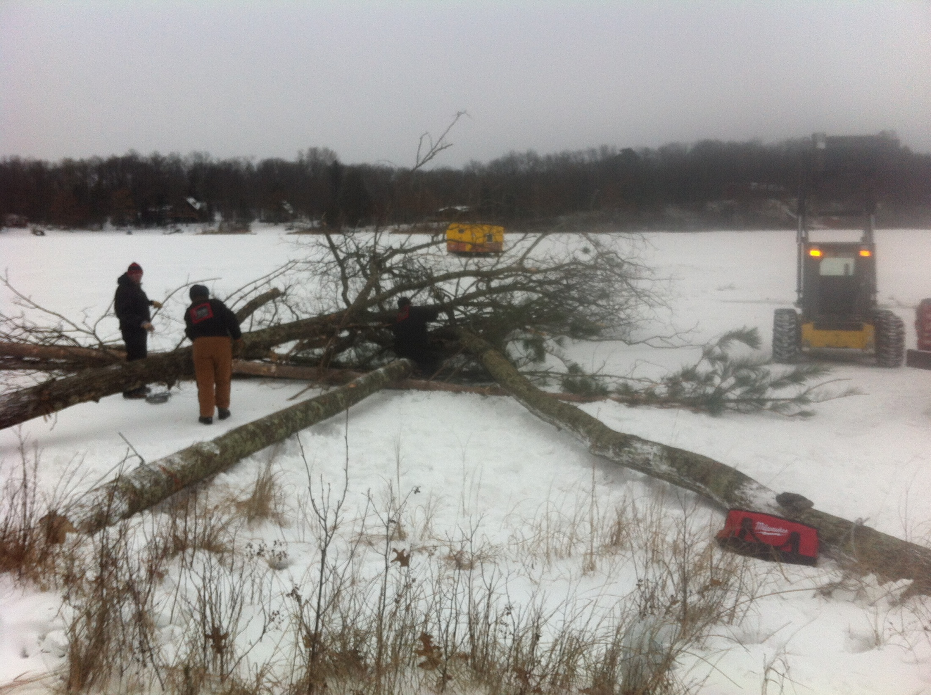

Slide 10
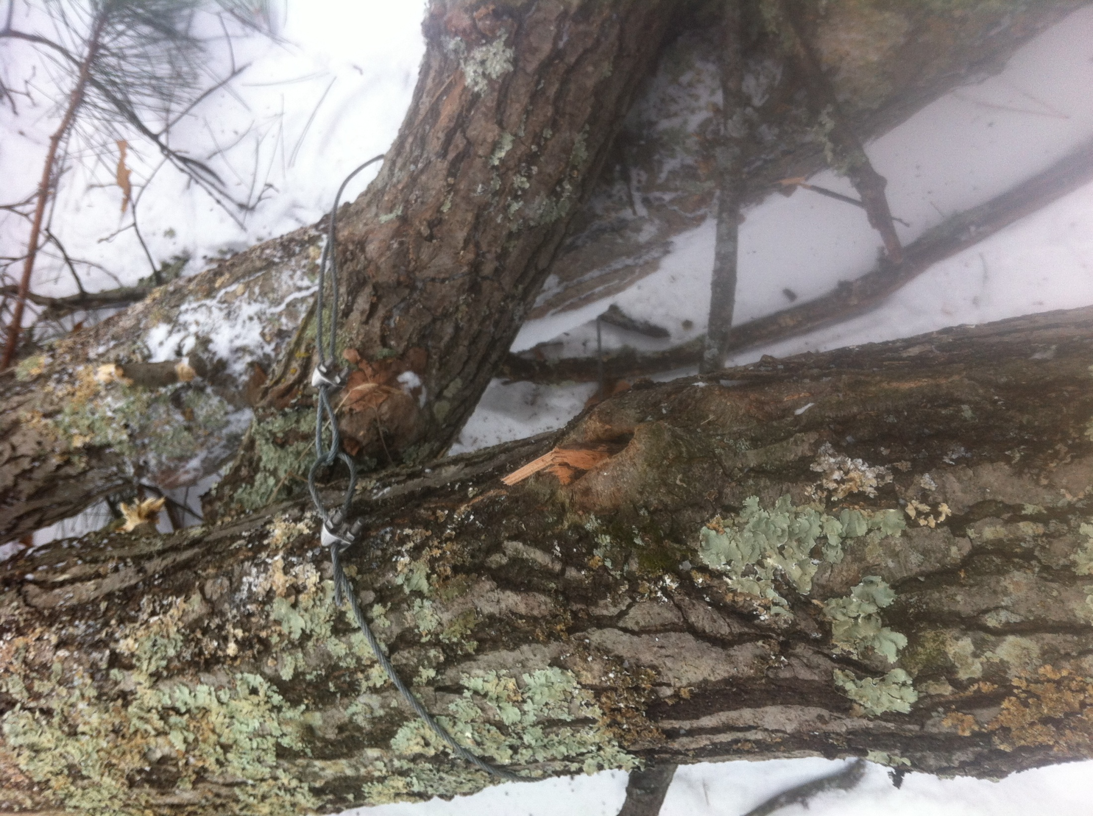

Slide 11
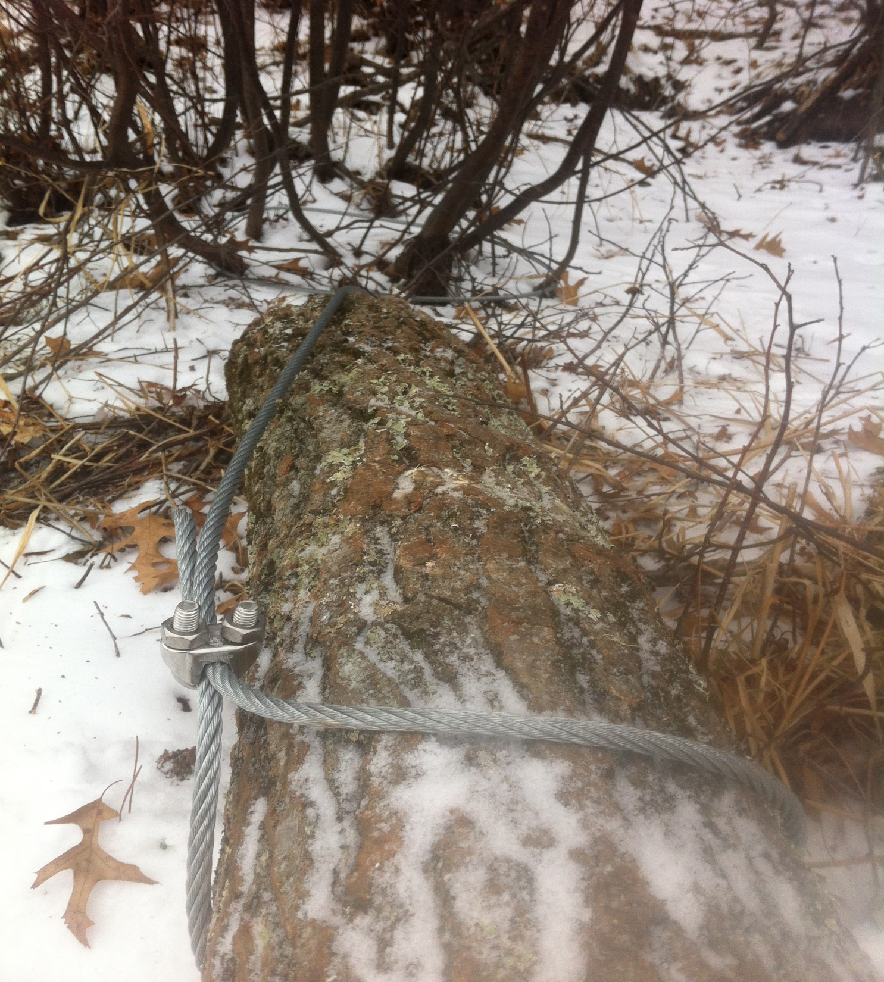

Slide 12
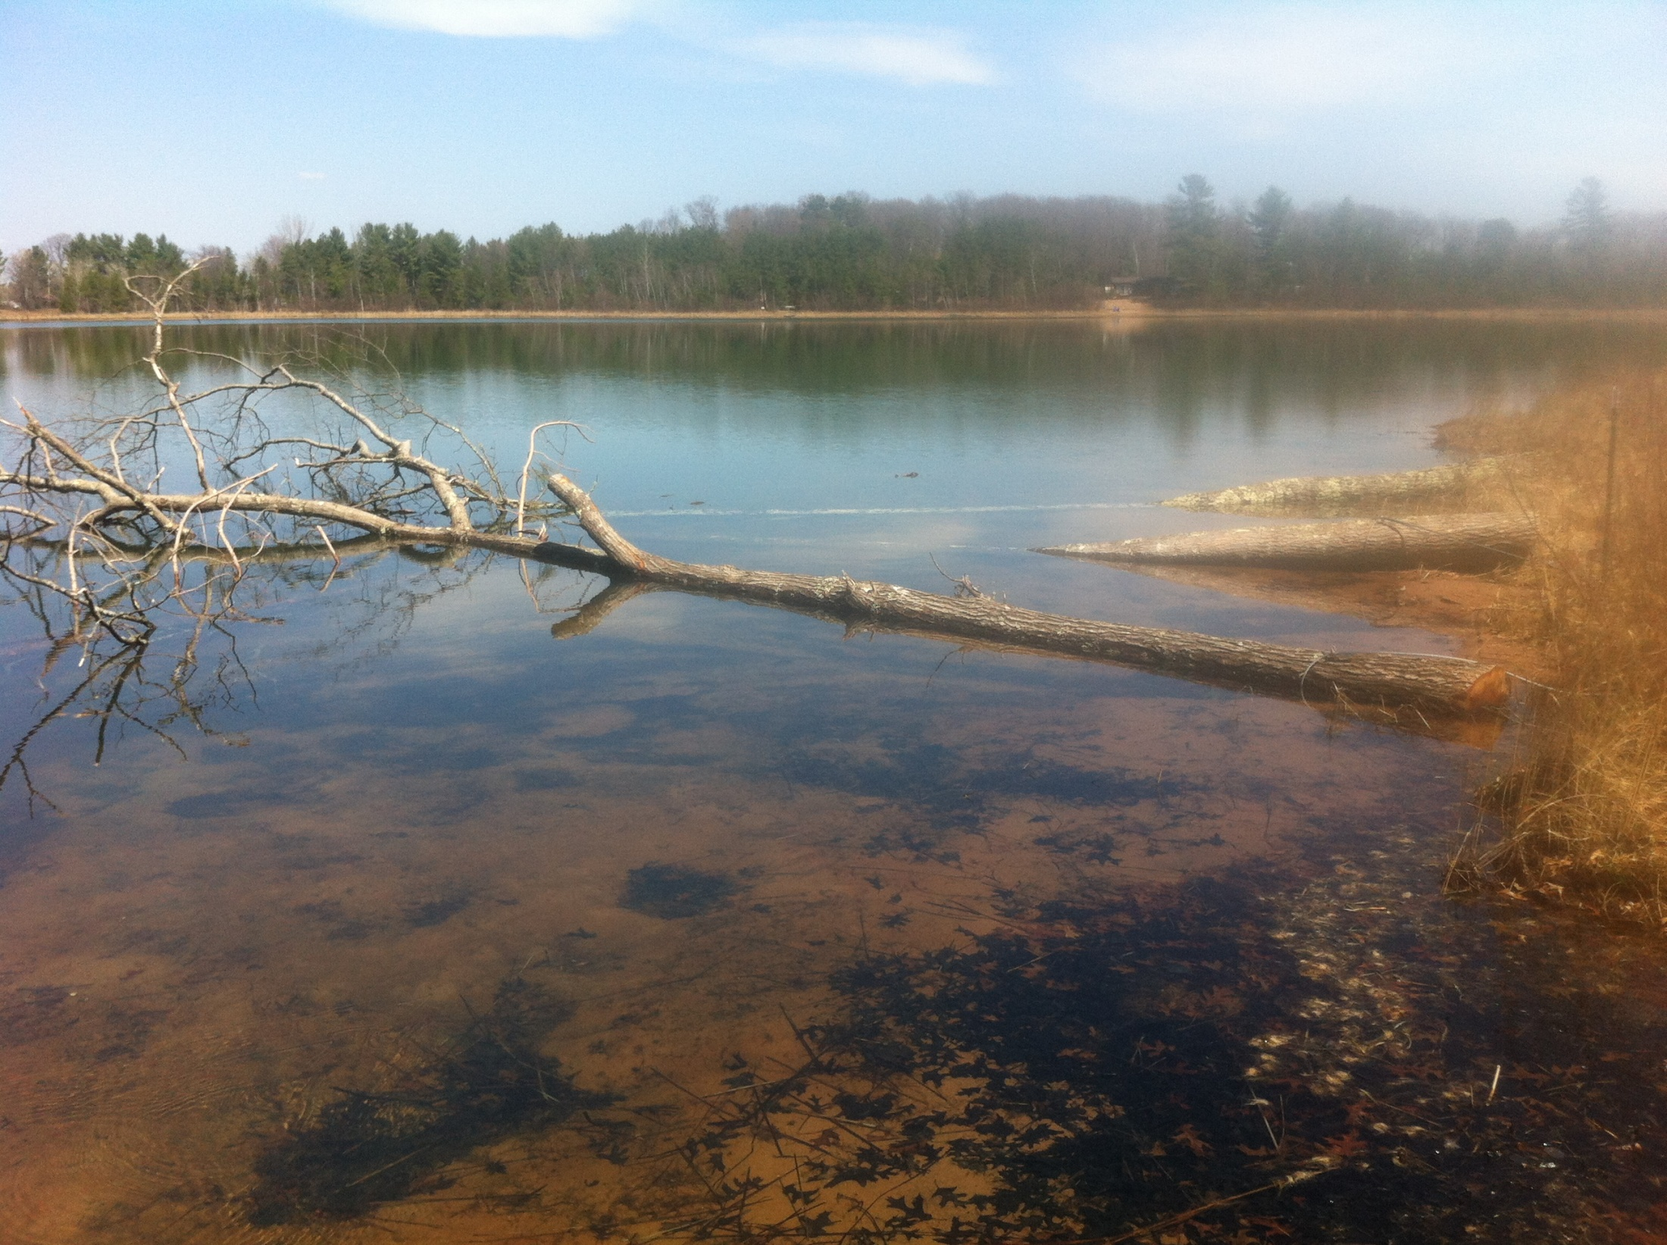

Slide 13
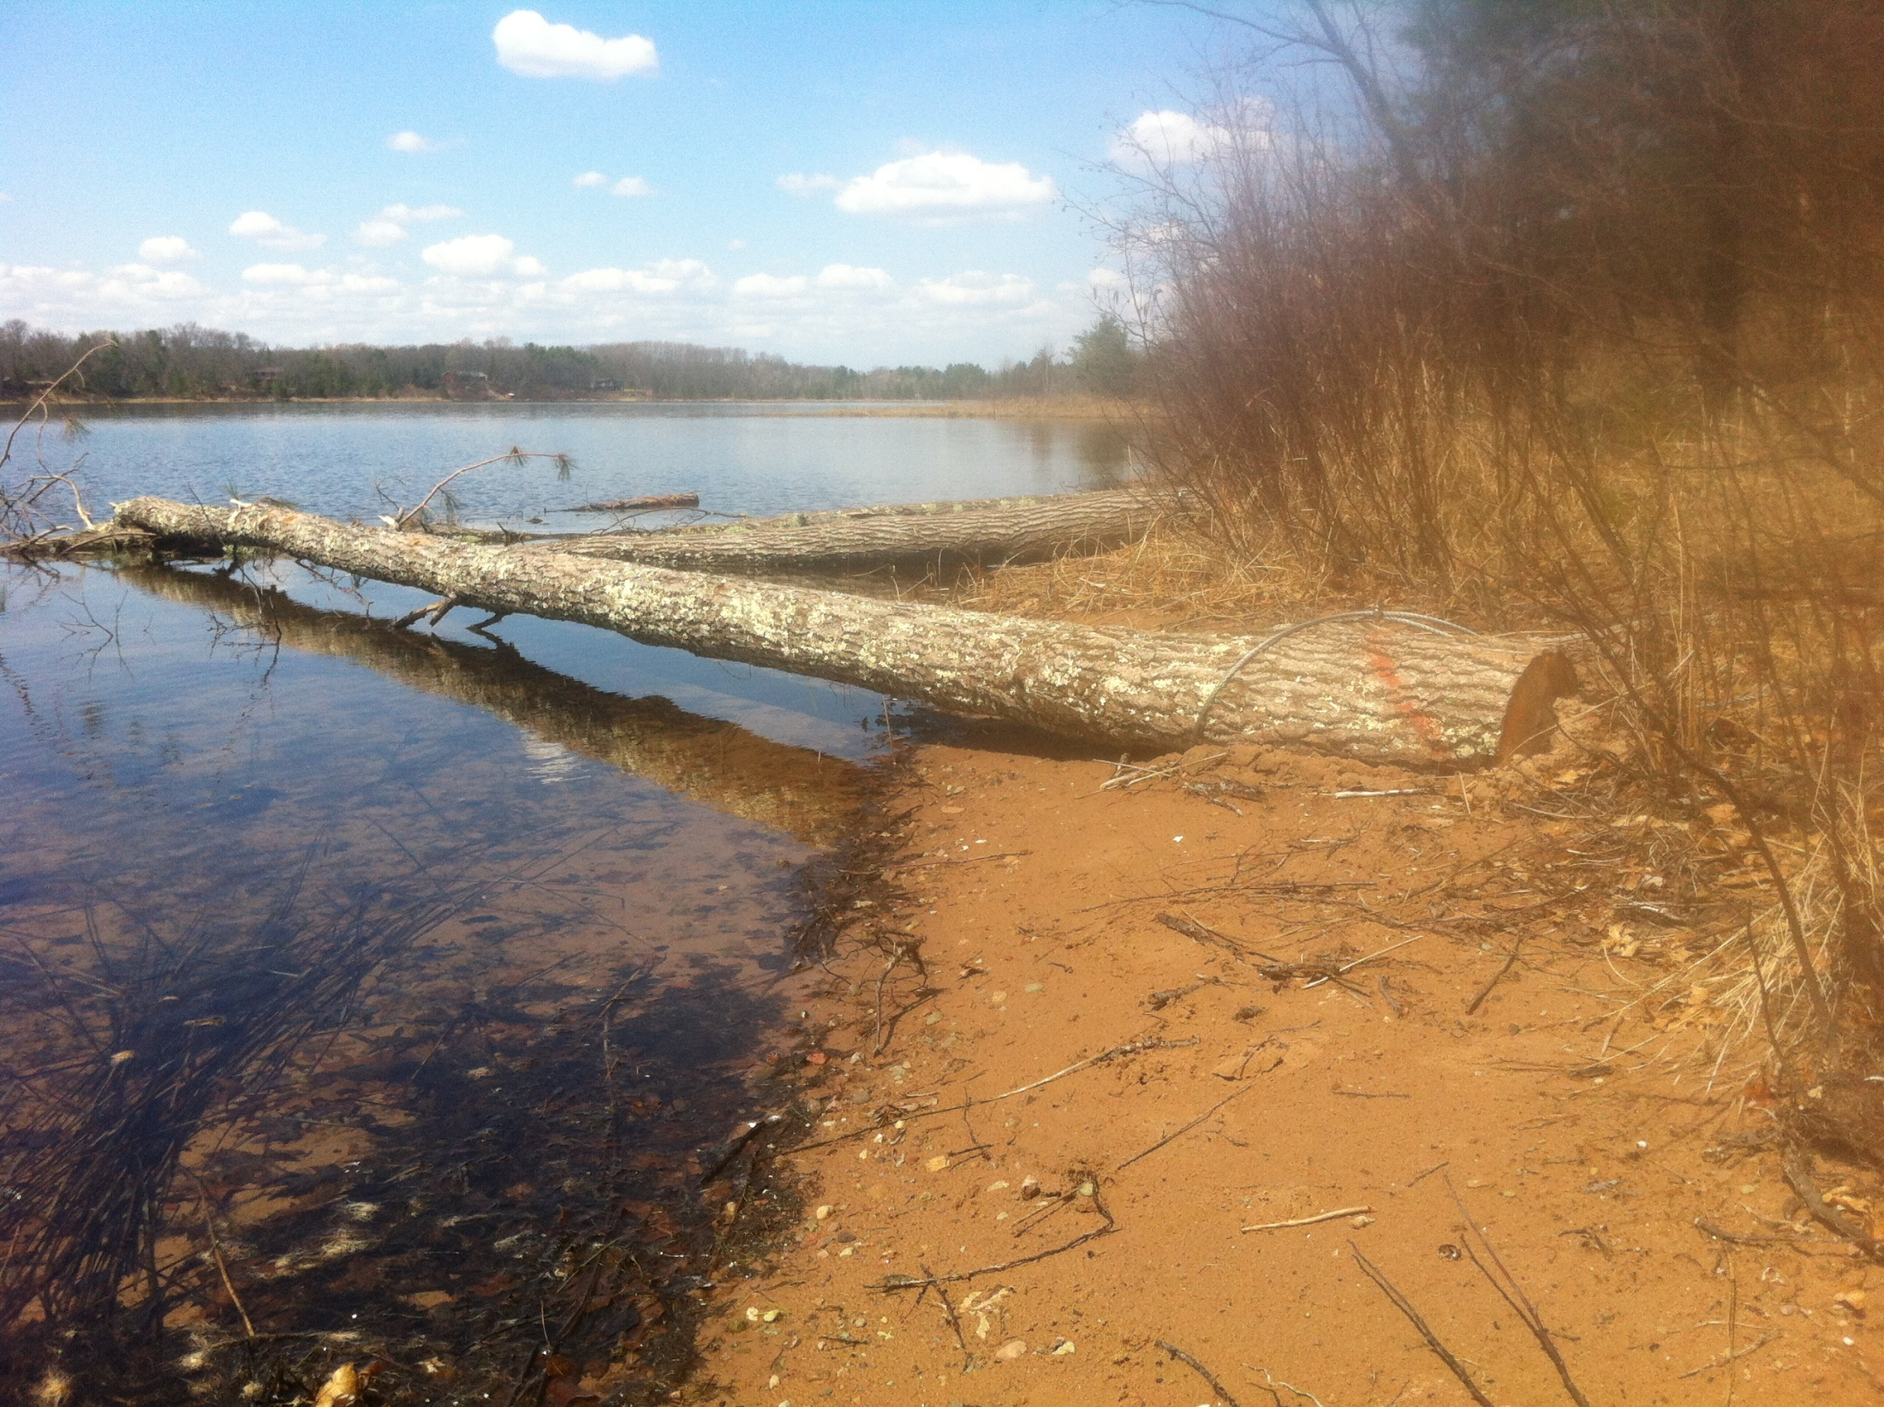

Slide 14
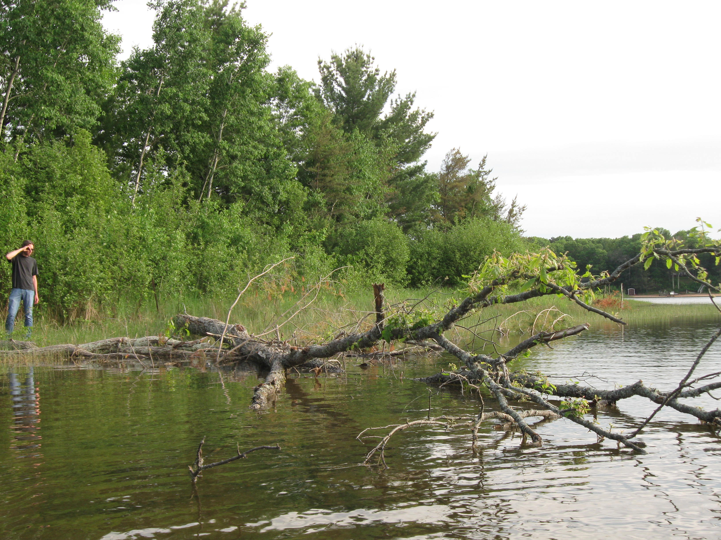

Slide 15
